Slide 1
Hydrocarbon Extraction
Flare Design
Colton Davies

Slide 2
Motivation
Mitigate harmful oil extraction byproducts
Proper combustion procedures for excess gas prevents greenhouse effect within the atmosphere
Flaring the hydrocarbons (CH4, C2H6) encountered during oil extraction produces less harmful reaction products (H20, CO2, NO, NO2)
High NOx concentrations can be avoided through careful flare design

Slide 3
Methods
MATLAB Cantera implementation
First iteration with a Well-Stirred-Reactor (WSR) model
Second iteration with a premixed flame for better physical approximation
Contains gas kinetic mechanism to simulate gas transport properties through the flame
Compare to laminar diffusion and turbulent flame approximations
Methane, ethane, and air mixture for the reacting fuel

Slide 4
Well Stirred Reactor Approximations

Slide 5
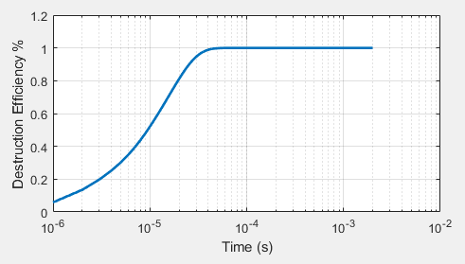
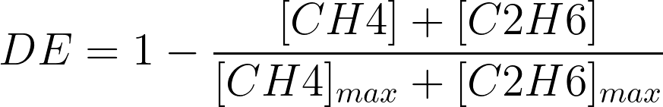




Destruction Efficiency
Goal: Verify 99% of CH4 and C2H6 are destroyed in combustion process. Approach/conditions: Iterating on residence time, equivalence ratio, and examine reactor volume
Result
Conclusion: With a quite high residence time, as well as a low equivalence ratio, the methane and ethane completely combust within 45 microseconds, with the volumetric air flow rate through the calculated reactor volume. Altering those two parameters can drastically change the speed or effectiveness of the destruction of the fuel, so by iterating, we are able to tune the residence time to educate the necessary volume and direct any change on the equivalence ratio to keep the NOx limit under 5ppm.
$$τ=22 s$$
$$ϕ=0.17$$
$$Q_{air}=4.72 kg/s$$
$$V_{reac}=85.35 m^{3}$$

Slide 6
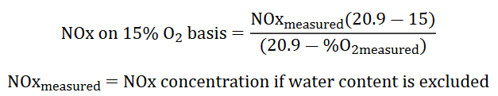
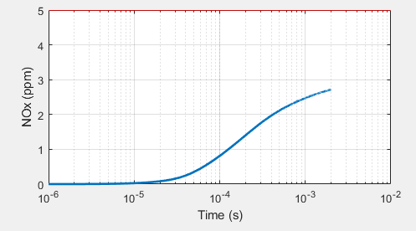
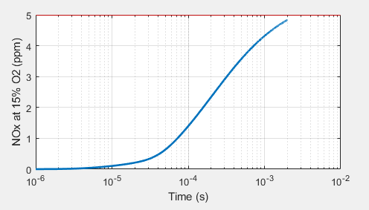
NOx Limit
Verify that the NOx stays below the limit
Alter equivalence ratio and residence time to keep concentration below 5 ppm
The NOx initially produced stays well below the limit, but once corrected with the 15% O2 basis calculation, it rises to just below the 5 ppm limit, hovering around 4.8 ppm.
Any increase to equivalence ratio will spike the NOx concentrations, this is due to temperature increasing for stoichiometric combustion, and higher combustion temperature leading to higher NOx emissions. The rate of reaction for NOx increases dramatically with temperature.
Source: Project Outline

Slide 7
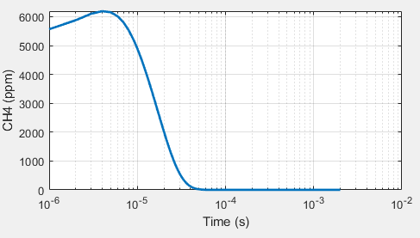
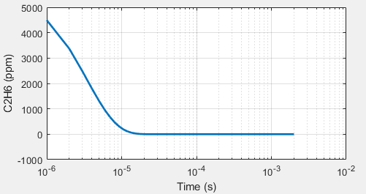
Fuel Concentrations
Methane and ethane concentrations (ppm) to corroborate ignition process and complete combustion.
The increase in methane for the first few microseconds is likely due to the inserted OH in the system taking time to start the ignition process within the reactor.
Once both fuel components reach zero concentration, we also know that our destruction efficiency requirement is attained.

Slide 8
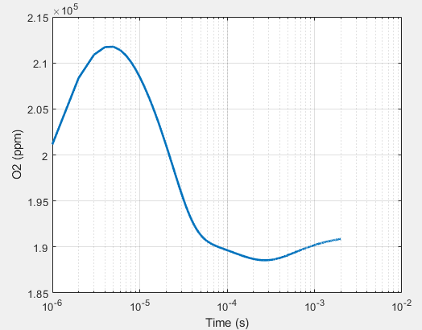
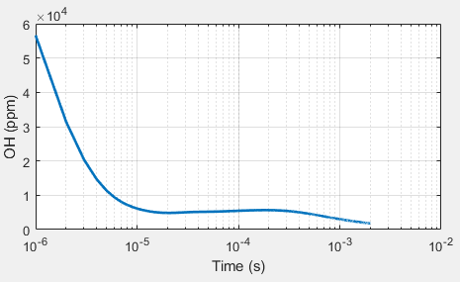
Reactor Concentrations
OH inserted, and O2 should deplete as combustion proceeds
Conclusion: The OH depletes as expected during combustion, but the O2 fluctuates within the reactor. My theory as to why this occurs is that the fuel mixture of air, ethane, and methane is still being pumped into the reservoir and the inserted OH takes a short while to get the WSR into combustion temperatures for O2 to be consumed.

Slide 9
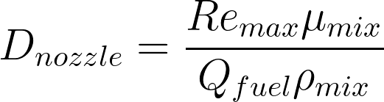
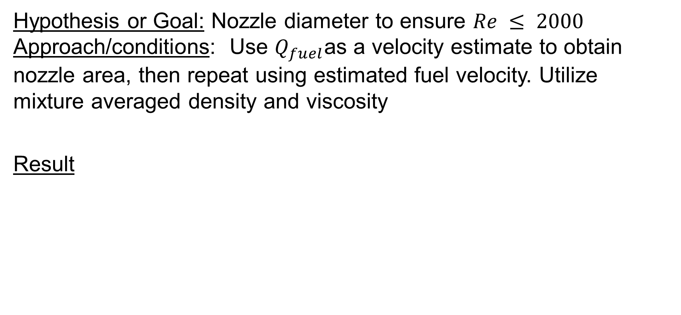
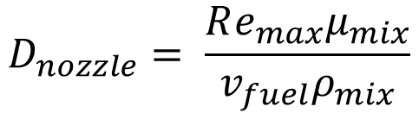
Nozzle Diameter
Hypothesis or Goal: Nozzle diameter to ensure $Re ≤ 2000$ Approach/conditions: Use $Q_{fuel}$as a velocity estimate to obtain nozzle area, then repeat using estimated fuel velocity. Utilize mixture averaged density and viscosity
Result
$$D_{nozzle}= \frac{Re_{max}μ_{mix}}{v_{fuel}ρ_{mix}}$$
$D_{nozzle}=1.19 m$ and $A_{nozzle}=1.11 m^{2}$at $Re=1786$

Slide 10






Physical Parameters
Hypothesis or Goal: Use estimated nozzle values to calculate design specifications Approach/conditions: Inner diameter must be 2x the nozzle diameter, and wall thickness should be 1/8 an inch.
$${ND}_{flare}=1.19 m$$
$$Cost=\$7.71/kg$$
$$H_{flare}=4.76 m$$
$$Mass_{steel}=ρ_{steel}V_{steel}=1239 kg$$
$$Total Cost=\$9563$$
$${OD}_{flare}=2.39 m$$

Slide 11
Premixed Flame Approximations

Slide 12
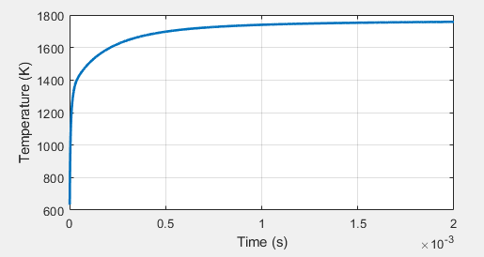
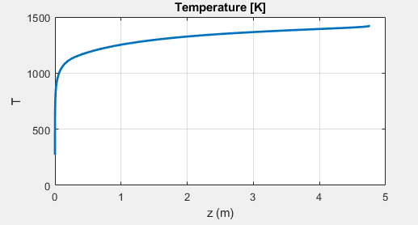
Premixed Flame Temp Comparison
The temp in the flame should be lower than the reactor due to gas transport estimated in the flame model.
The flame is one dimensional.
The temp in the flame is lower than the temp in the reactor approximation, corroborating that gas transport energy methods will result in lower temp combustion.
Molecules take time to travel, collide, and react within the flame chamber vs. the reactor simulating an entirely ideal gas within a perfectly mixed reservoir.
REACTOR
FLAME

Slide 13
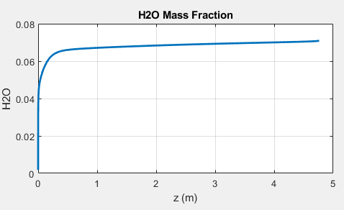
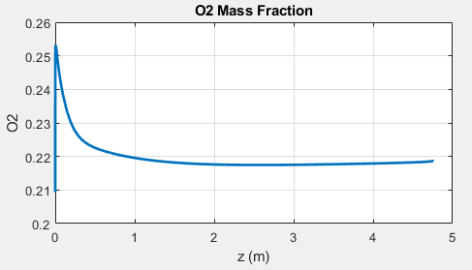
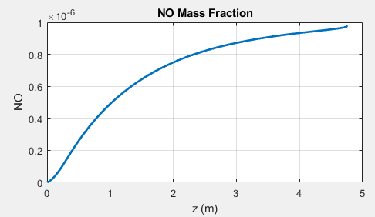
Premixed Flame Concentrations
H20, NO, O2 upstream and downstream of flame
This O2 depletion makes more sense than the reactor result, as the fuel lean mixture should combust and consume a portion of the O2 over the length of the flame. The NO concentration (which is approximated as total NOx) barely reaches 1ppm at the end of the flame length

Slide 14
Simulation Alterations
Premixed free flame simulation should prove higher fidelity and more accurate, as it uses the gas transport mechanisms contained in GRI30 for a 1D flame.
Equivalence ratio can be increased, as the NOx concentration in the flame is reasonably lower than the WSR simulation.
This results in a higher temperature however, so the physical parameters of the flare design shouldn’t change unless the material is proven under the new temperature value.

Slide 15
Laminar Diffusion and Turbulent Flames

Slide 16


Laminar Diffusion Flame Length
Approach/conditions: Roper flame height correlation for a circular port
Result
For a nozzle more than a meter in diameter, this flame height doesn’t seem entirely unreasonable.
A laminar diffusion flame should have a longer flame length when compared to a premixed laminar flame as the only method of oxidizer and fuel interaction is diffusion.
The gas has more barriers to combusting efficiently, so the flame process is spread over a longer axial distance.
$$L_{f}=1330\frac{Q_{fuel}\frac{T_{∞}}{T_{flame}}}{ln⁡(1+\frac{1}{S})}$$
$$L_{f}=101.07 m$$

Slide 17
Turbulent Premixed Flame
Hypothesis or Goal: Turbulent premixed flame should be advantageous in destruction efficiency.
Conclusion:
Turbulence intensity or turbulent eddies should increase the efficiency of combustion as the fuel interacts more violently throughout the flame to support molecule interaction.
In turn, this corresponds to a lower chance of methane or ethane directly entering the atmosphere, consistent with the goal of flaring the gas in the first place.
This also should relate to a shorter flame length compared to the other methods explore.

Slide 18
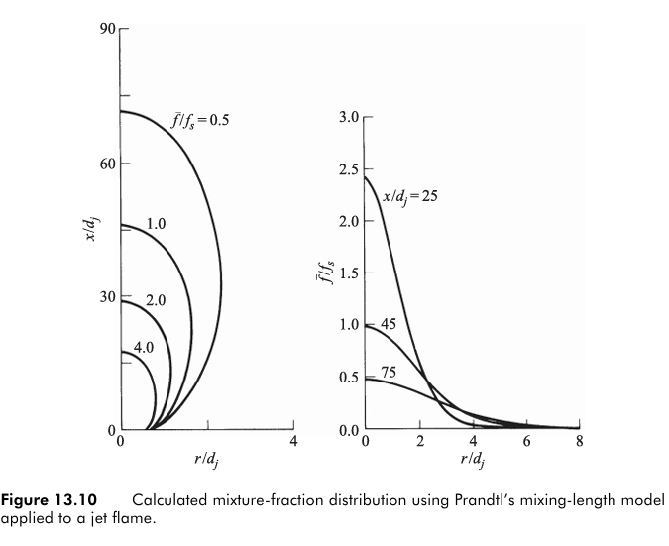


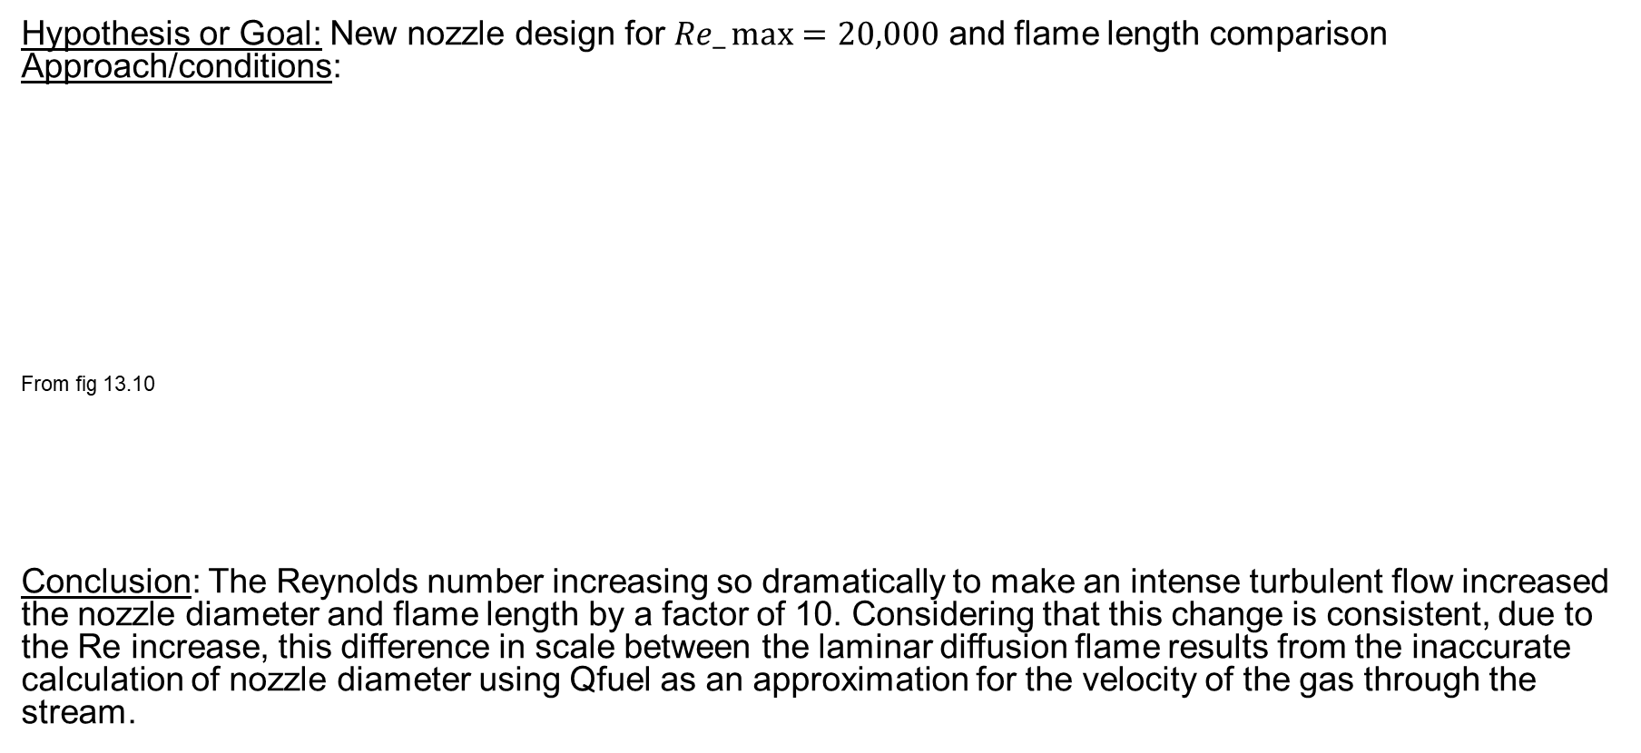


Turbulent Non-premixed Flame
Hypothesis or Goal: New nozzle design for $Re_\max{=20,000}$ and flame length comparison Approach/conditions:
From fig 13.10
Conclusion: The Reynolds number increasing so dramatically to make an intense turbulent flow increased the nozzle diameter and flame length by a factor of 10. Considering that this change is consistent, due to the Re increase, this difference in scale between the laminar diffusion flame results from the inaccurate calculation of nozzle diameter using Qfuel as an approximation for the velocity of the gas through the stream.
$$D_{nozzle}=11.19 m$$
$$\frac{L_{f}}{D_{nozzle}}=108$$
$$∴$$
$$L_{f}≈1289 m$$

Slide 19
Environmental Impact
Goal:
Calculate CO2 emissions over the course of one year compared to pure methane
Approach/conditions:
Methane has a GWP of 30 and Ethane a GWP of 10, utilizing the same flow rate as the reactor and flame approximations.
Result
Conclusion:
Unburnt methane and ethane, due to their large GWP produce much more CO2 equivalent emissions compared to when the fuels are combusted.
Ethane, appears to create more equivalent carbon dioxide than methane does, this results from 1 mole of ethane combusting into 2 moles of carbon dioxide, where 1 mole of methane combusts to produce 1 mole of carbon dioxide within the stoichiometric balanced reacitions.
(kg/year) | Combusted CO2 Equivalent | Unburnt CO2 Equivalent
Methane (CH4) : | 6.72e5 | 2.02e7
Ethane (C2H6) : | 1.47e6 | 1.47e7

Slide 20
Inefficiencies in Flaring
The previous simulations provide combustion trends and values that might give an idea of what occurs in a real-world system.
Destruction efficiency is likely to be much lower for such a large system to vent and flare underground methane and ethane
A lower destruction efficiency then leads to more unburnt methane or ethane directly entering the atmosphere.
Conclusion:
Methane flaring prevents harmful buildup of more potent greenhouse gasses by producing more CO2 and limiting CH4.
High radiative forcing in under-reported methane that is present in unlit flare exhausts marks a negligence on the companies in charge of latent flares.
This solution is a result of poor infrastructure to support harnessing this methane as a usable fuel to produce useful energy instead of only releasing exhaust into the atmosphere.

Slide 21
Conclusion
WSR and Premixed free flame
The WSR assumes complete mixing, which produces entirely uniform combustion throughout
The free flame model accounts for the flame front and gas transport properties for the species present within the length of the flame
Laminar diffusion, Turbulent premixed, and Turbulent Non-premixed flames
Laminar diffusion flames should result in longer flame lengths, as well as a lower fuel destruction efficiency due to less mixing
Both turbulent flames should have shorter flame lengths due to more mixing, causing more efficient fuel consumption
Highest to Lowest flame length: Laminar diffusion, turbulent non-premixed, and turbulent premixed
Poorly designed, unlit, or decrepit flare systems can produce unwanted methane and ethane emissions beyond standard estimates.
More resources towards flare efficiency and upkeep can remedy this
Otherwise, company or government infrastructure could be used to harness the methane and ethane underground as a fuel source directly, as opposed to releasing greenhouse gases to preserve profit margins.

